Slide 1






Slide 2
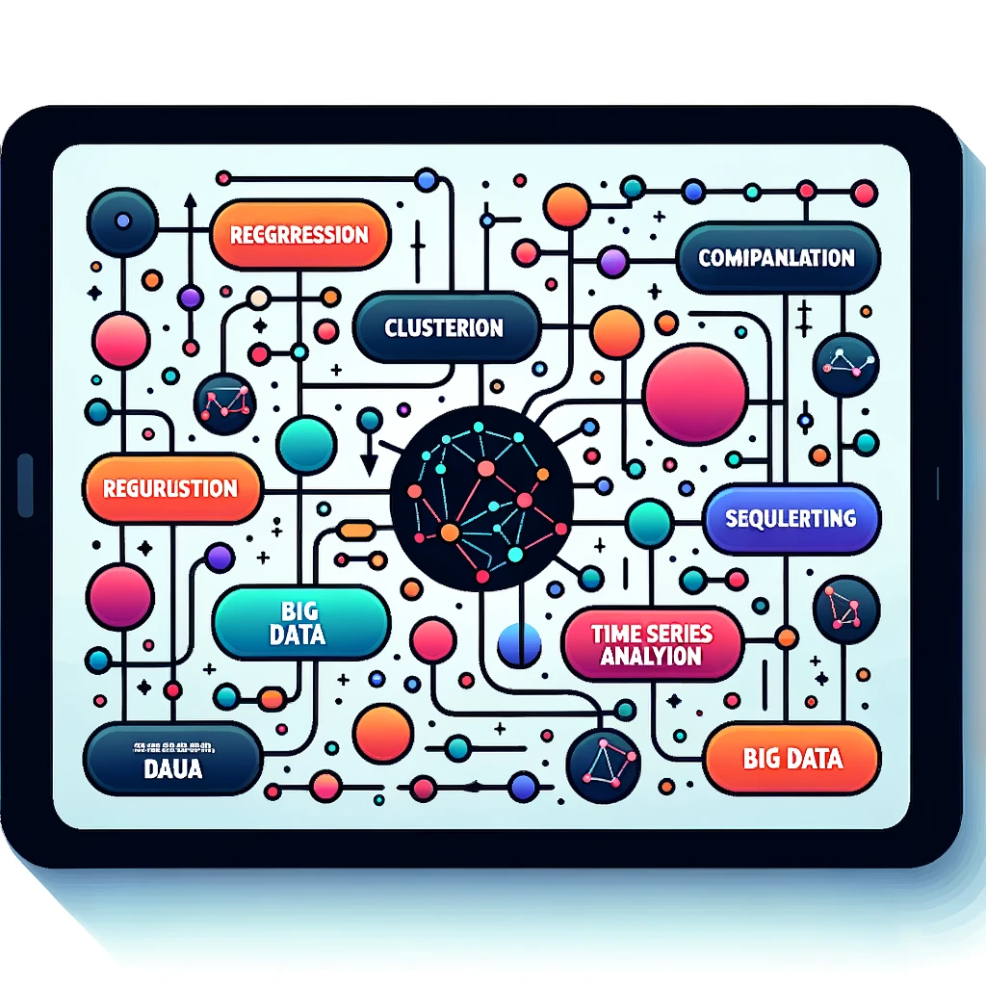


OUTLINE
Executive Summary
Introduction
Methodology
Results
Visualization – Charts
Dashboard
Discussion
Findings & Implications
Conclusion
Appendix

Slide 3

EXECUTIVE SUMMARY
Analyzing programming languages professionals.
Methodologies:
Data collection sourced from a technology survey dataset.
Data preprocessing involved filtering, categorization, and normalization.
EDA spotlighted top-used programming languages.
IBM Cognos Dashboard facilitated interactive visual representations, offering insights into tech preferences
Key Findings:
Web technologies, especially JavaScript and HTML/CSS, dominate the tech landscape.
Visualization tools like IBM Cognos provide precise data representation, enhancing comprehension.
Demographic data, bifurcated by gender and education, yields insights into tech preferences.
Implications:
Highlighting the need for organizations to prioritize web technologies in training and recruitment.
The importance of tailored resources based on top programming languages and demographic inclinations.
Aiding in strategy formulation for targeted marketing, recruitment, and training programs.

Slide 4

INTRODUCTION
Background: The tech industry's dynamic nature demands a clear understanding of current trends and demographic inclinations. With the rise of new programming languages and tools, it's crucial to identify the prevalent preferences.
Determine Dominant Programming Languages
Source comprehensive technology survey data.
Identify most used languages and tools.
Construct detailed visual representations.
Demographic Analysis by Education and Gender
Utilize data visualization tools.
Analyze data based on gender and education metrics.
Extract insights to inform strategy and outreach.

Slide 5

METHODOLOGY
Data Collection:
Utilized a technology survey dataset, from a diverse group of professionals.
Data Wrangling and Preprocessing:
Employed filtering techniques to ensure data consistency.
Categorized and normalized responses for accurate analysis.
Exploratory Data Analysis (EDA):
Identified key trends and patterns, utilizing frequency distributions to highlighting the dominance of various technologies
Data Visualization with IBM Cognos:
Crafted interactive visual representations to offer insights into respondents technology preferences.

Slide 6
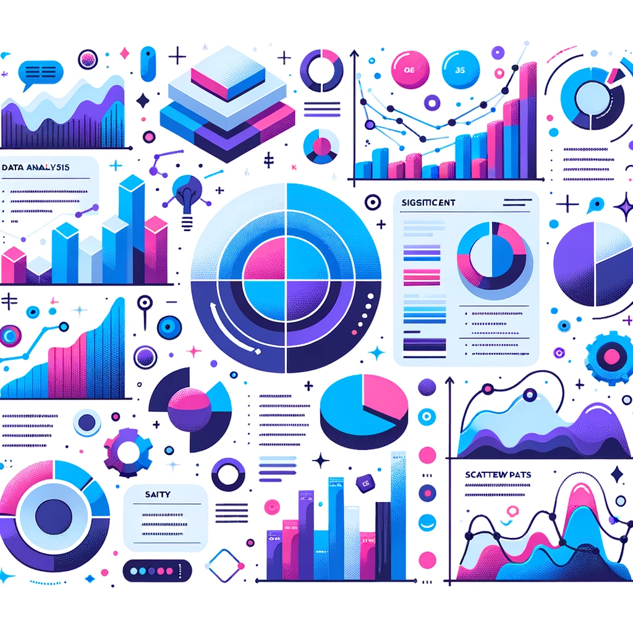
RESULTS
Top Programming Languages:
JavaScript, HTML/CSS, and SQL emerged as the three most commonly used programming languages among respondents.
Visualization Insights:
Utilizing IBM Cognos Dashboard for visualization underscored the significance of web technologies in the current tech landscape.
Demographic Distribution:
Analysis revealed detailed insights into the programming languages and technologies preferred by different genders and across various formal education levels.
Predominant Technologies:
Web technologies, especially JavaScript and HTML/CSS, dominate the preferences, indicating their continued relevance and demand in the industry.
Demographic Specifics:
The data showed nuanced preferences in tech choices based on gender and formal education, which can be pivotal for targeted strategy formulation, marketing, and recruitment.

Slide 7
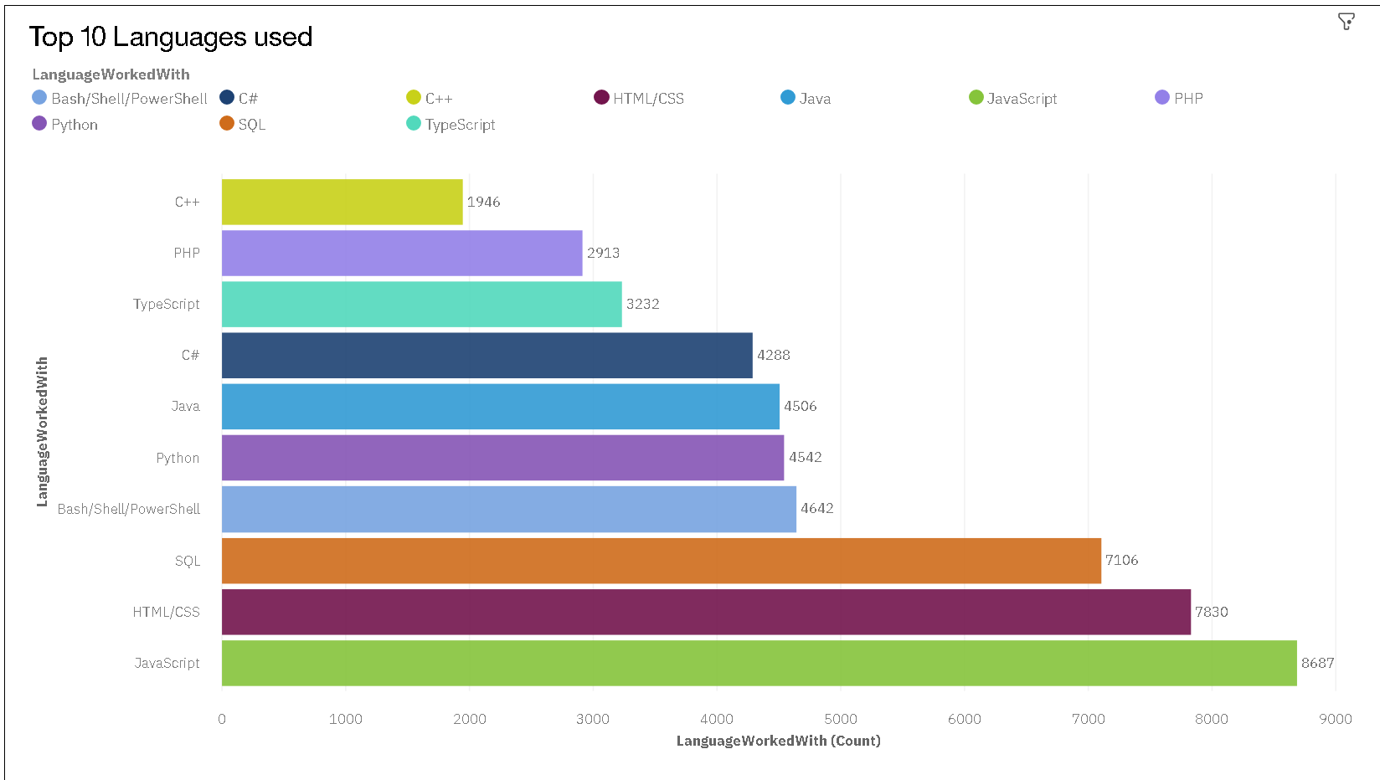
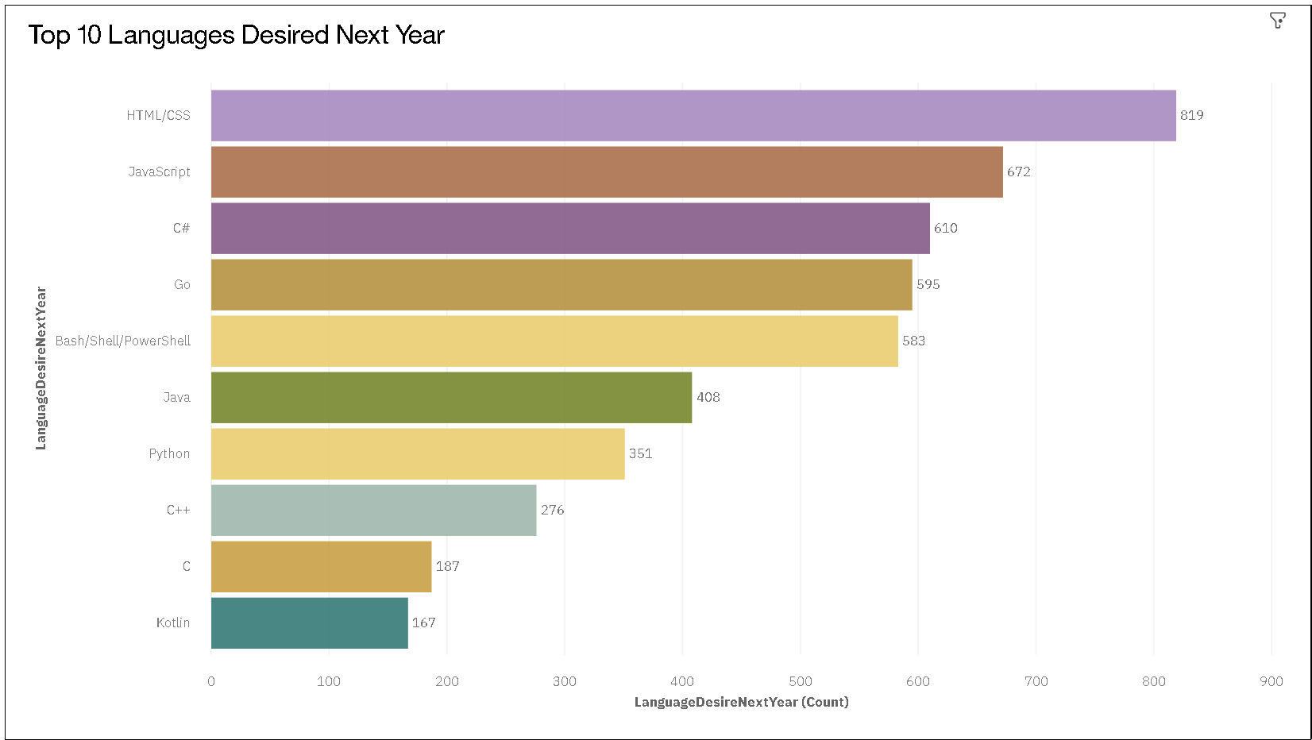
PROGRAMMING LANGUAGE TRENDS
Current Year
Next Year
<Bar chart of top 10 programming languages for the current year goes here.>
< Bar chart of top 10 programming languages for the next year goes here.>

Slide 8
PROGRAMMING LANGUAGE TRENDS - FINDINGS & IMPLICATIONS
Findings
JavaScript, HTML/CSS, and SQL are the top three languages professionals currently work with.
Despite their current prominence, there's a shift in desired languages for the next year, indicating evolving preferences.
The gap between current usage and desire for some languages, like TypeScript, suggests a rising interest in newer or previously less-adopted technologies.
Implications
Organizations need to adapt to the evolving tech landscape by offering training and resources in the languages seeing increased interest.
Recruitment strategies might need realignment, focusing on emerging languages to stay ahead in the competitive tech market.
The shift in desired languages suggests the importance of continuous learning and upskilling in the tech industry to stay relevant.

Slide 9
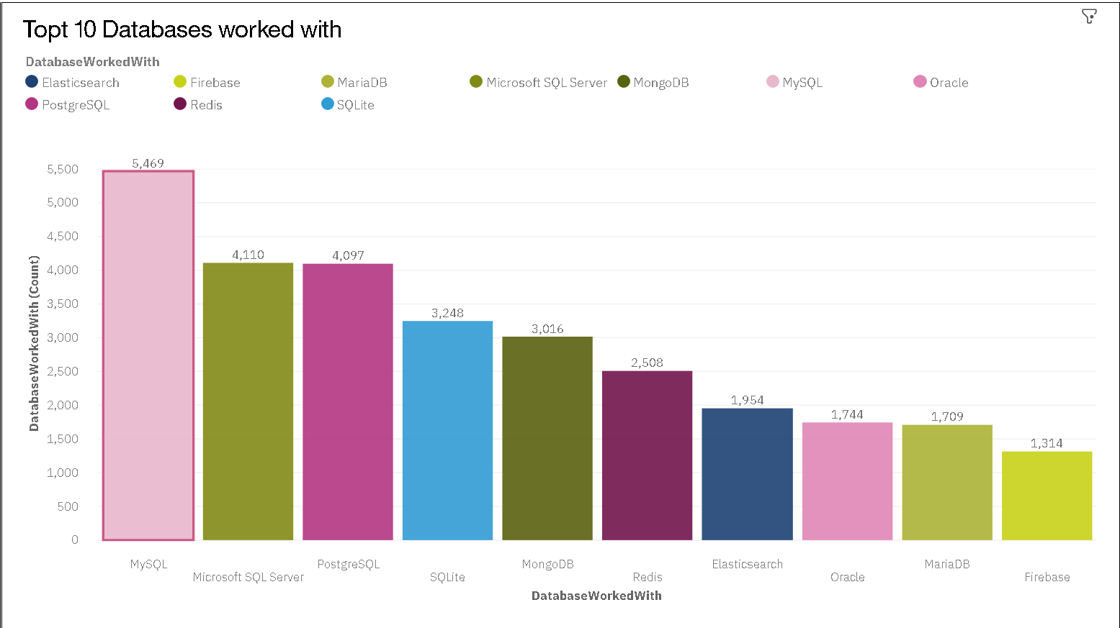
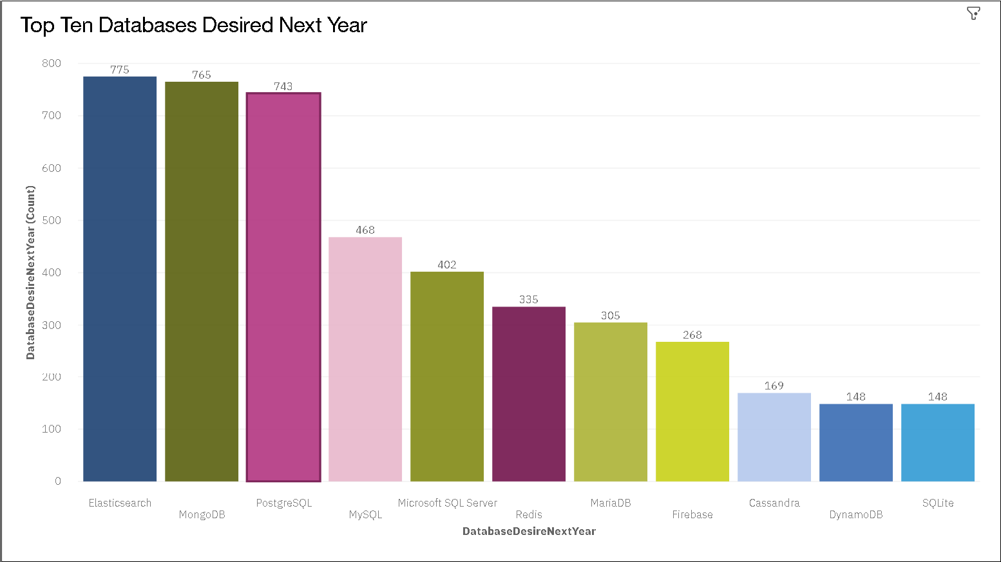
DATABASE TRENDS
Current Year
Next Year
< Bar chart of top 10 databases for the current year goes here >
< Bar chart of top 10 databases for the next year goes here.>

Slide 10
DATABASE TRENDS - FINDINGS & IMPLICATIONS
Findings
MySQL, PostgreSQL, and Microsoft SQL Server are the top three databases professionals currently utilize.
While MySQL remains a popular choice, there's a notable shift in desired databases for the next year, with PostgreSQL and MongoDB gaining traction.
The data suggests a divergence between current usage and future interest, especially for databases like Firebase and Elasticsearch.
Implications
As preferences evolve, organizations might consider diversifying their database technologies to cater to emerging trends.
The growing interest in non-relational databases like MongoDB indicates a broader shift towards flexible and scalable database solutions.
Continuous training and upskilling in newer database technologies will be vital for IT professionals to stay ahead in their roles.

Slide 11
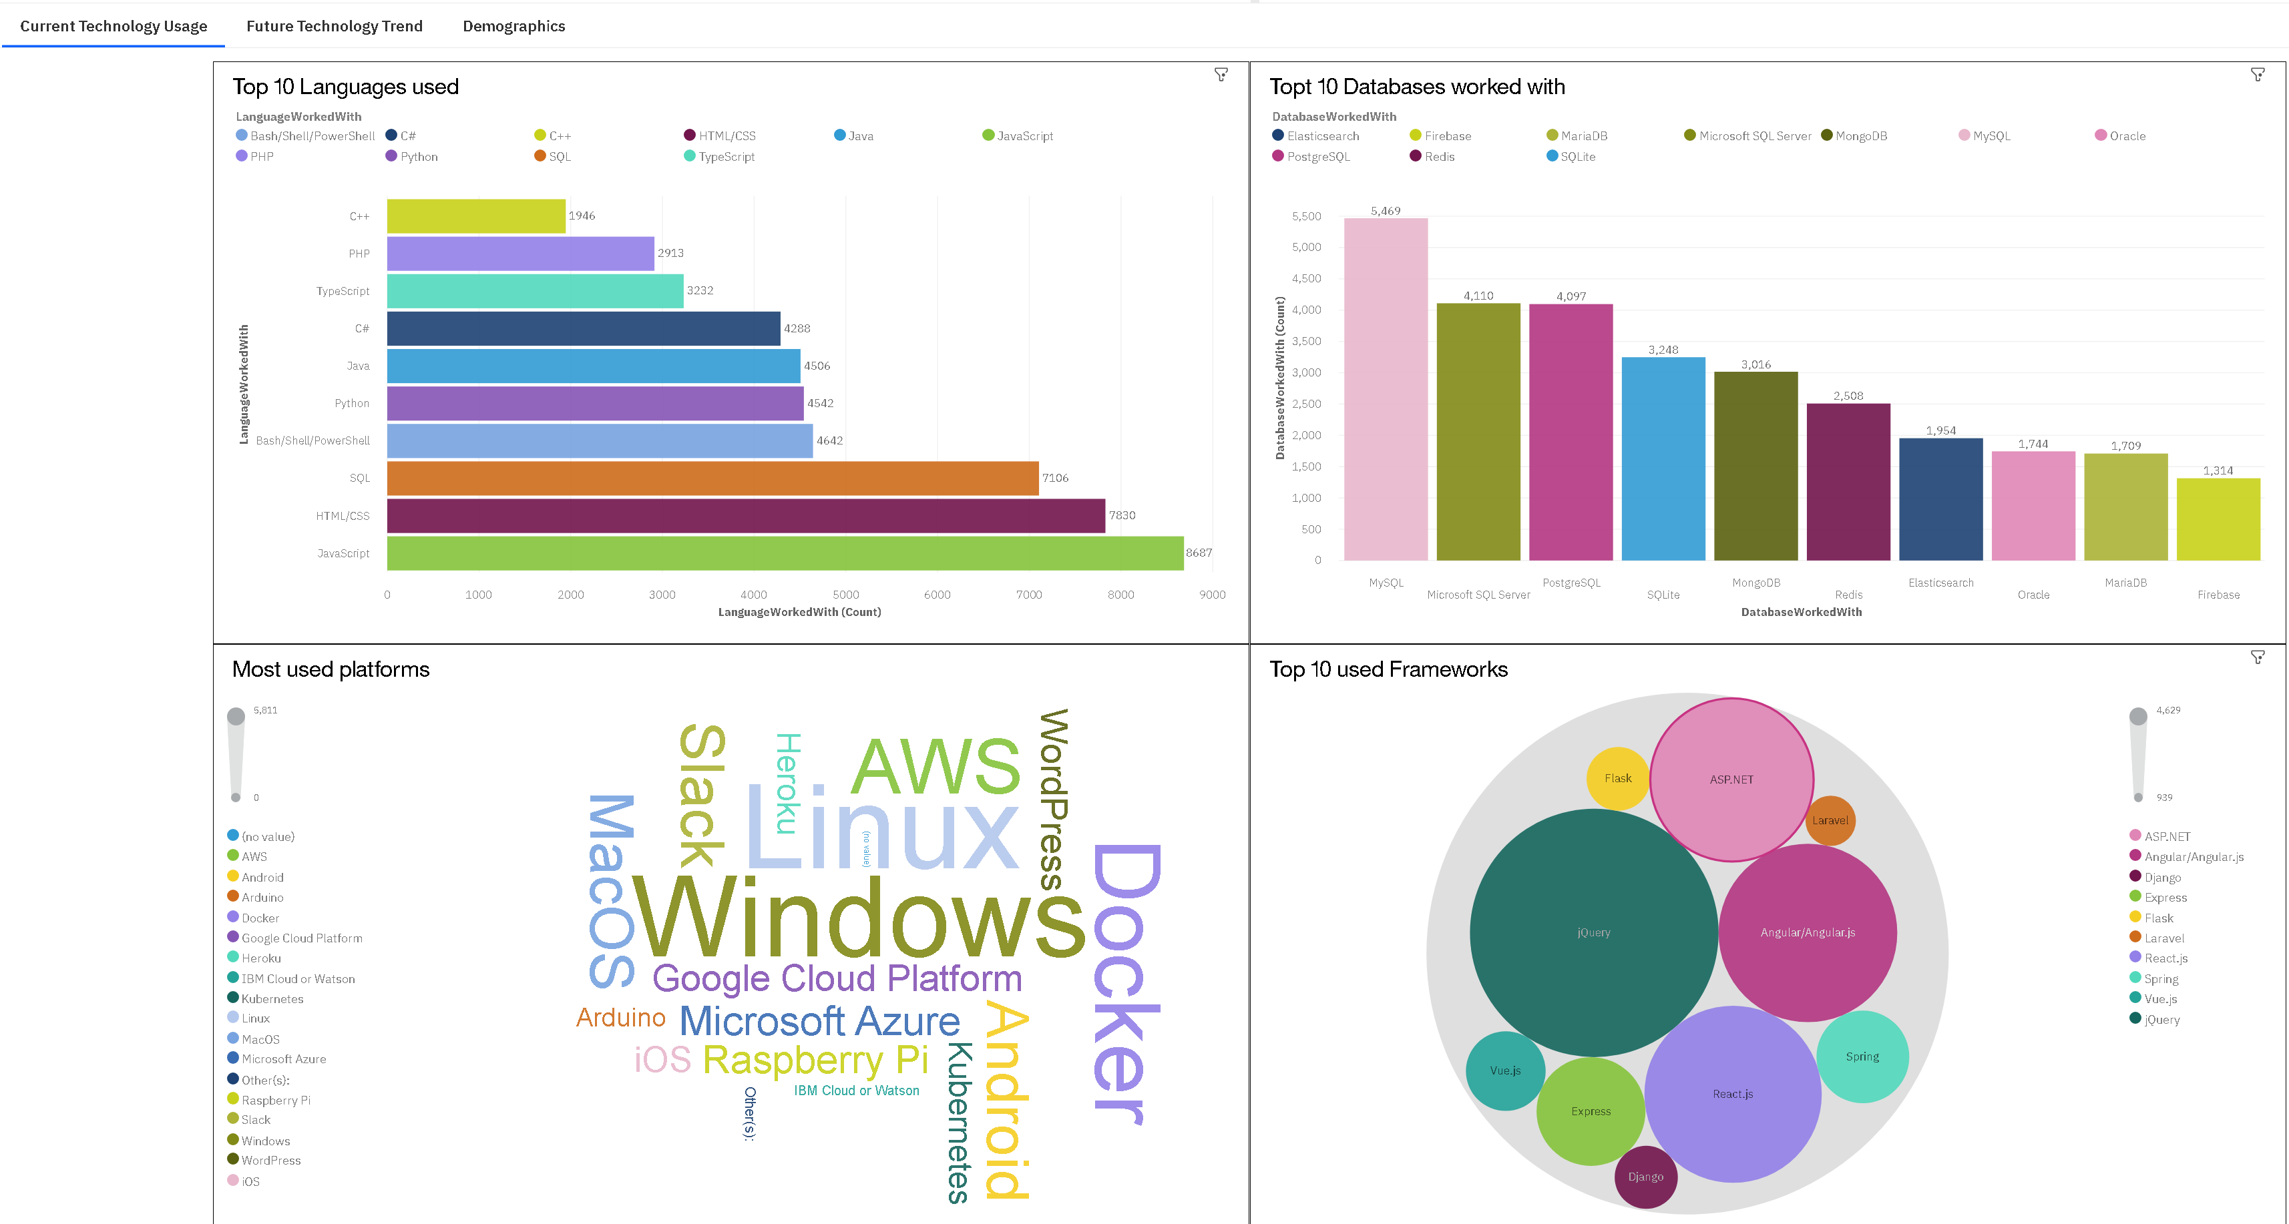
COGNOS DASHBOARD
https://dataplatform.cloud.ibm.com/dashboards/26198de9-9548-43cd-80be-7b9f186a6672/view/4019b81b12b334e070e8bde407ca29022c63235ab4bb8304d2867b4907687797f03d1195c87d4a0edd470136f1bf1a5ecc

Slide 12
DASHBOARD TAB 1
Screenshot of dashboard tab 1 goes here

Slide 13
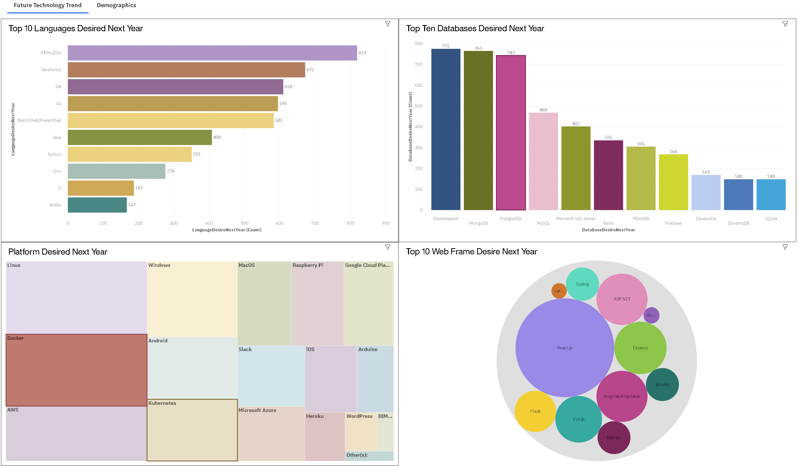
DASHBOARD TAB 2
Screenshot of dashboard tab 2 goes here

Slide 14
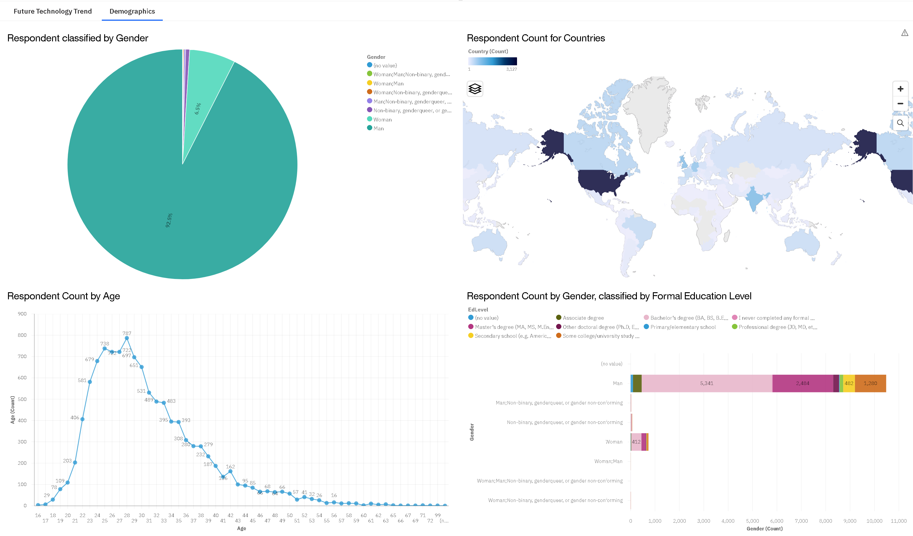
DASHBOARD TAB 3
Screenshot of dashboard tab 3 goes here

Slide 15

DISCUSSION
Evolving Preferences: - The shift from traditional to newer technologies is evident. What factors could be driving this change? Industry demand? Ease of use? Performance?
Training & Upskilling:- With the clear movement towards certain technologies, how should educational institutions and companies adapt their training programs?
Industry Implications: - As preferences lean towards specific languages and databases, how might this impact startups versus established companies? What challenges and opportunities arise?
Future Predictions: - Given the current trajectory, which technologies might dominate in the next 5 years? How can organizations prepare?
User Experience vs. Performance: - Some technologies offer a better user experience while others boast superior performance. How do we strike a balance, and what do users prioritize?

Slide 16
OVERALL FINDINGS
Programming Language Dominance: JavaScript, HTML/CSS, and SQL are the most commonly used programming languages. However, there's a discernible shift in desired languages for the upcoming year, pointing to evolving tech preferences.
Database Preferences: MySQL, PostgreSQL, and Microsoft SQL Server are currently the leading databases among professionals. Interest in non-relational databases like MongoDB and versatile solutions like Firebase is rising, indicating a broader shift in database preferences.
Demographic Insights: There are nuanced tech preferences based on gender and formal education, providing a detailed view of demographic inclinations.

Slide 17
OVERALL IMPLICATIONS
Training & Development: Organizations and educational institutions should adapt to the evolving tech landscape by offering training in emerging languages and databases.
Recruitment Strategies: As tech preferences change, recruitment should focus on skill sets that align with emerging trends to attract top talent and stay competitive.
Product Development: Companies developing tech products or platforms should consider the rising popularity of specific languages and databases to cater to a larger audience.
Market Opportunities: The shift in desired technologies suggests potential market opportunities for startups and established companies willing to adapt to the changing landscape.
Future-Proofing: Both professionals and organizations need to be agile, embracing continuous learning and upskilling to stay relevant in the dynamic tech industry.

Slide 18

CONCLUSION
Dynamic Landscape: The tech industry is constantly evolving. While some technologies like JavaScript and MySQL remain dominant, there's a shift towards newer tools and languages.
Demographic Impact: Tech preferences are influenced by factors like formal education and gender, reflecting the diverse backgrounds of professionals in the industry.
Need for Adaptability: The gap between current usage and desired technologies highlights the importance of continuous learning and adaptability for both organizations and individuals.
Educational & Job Opportunities: The changing preferences present opportunities for educational institutions and employers to realign their offerings with emerging trends.
Predicting the Future: Current data can serve as a predictive tool, hinting at potential future industry directions.
User-Centric Focus: For tech companies, the findings emphasize the value of aligning product development with the preferences and needs of their audience.

Slide 19

APPENDIX
Additional Resources:
Github Link to all course files
Link to Cognos Dashboard
Acknowledgments:
Coursera.org
IBM
Anaconda
Data Sources
All data sources can be referenced in the GitHub Repo for the course in the appropriate files

Slide 20
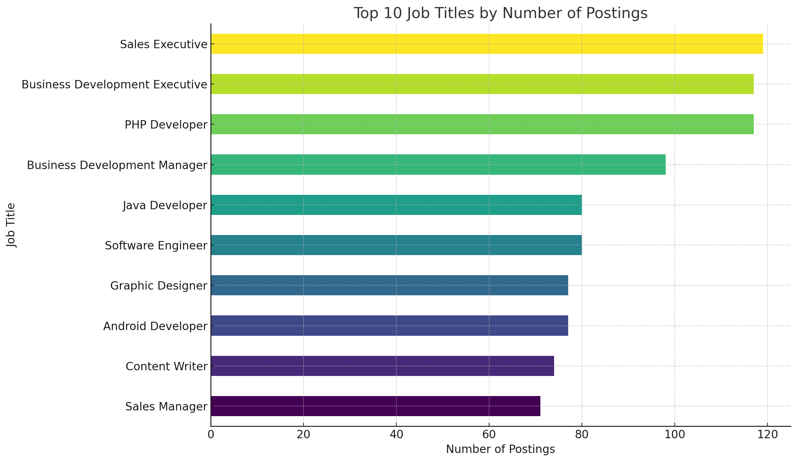
JOB POSTINGS
In Module 1 you have collected the job posting data using Job API in a file named “job-postings.xlsx”. Present that data using a bar chart here. Order the bar chart in the descending order of the number of job postings.

Slide 21
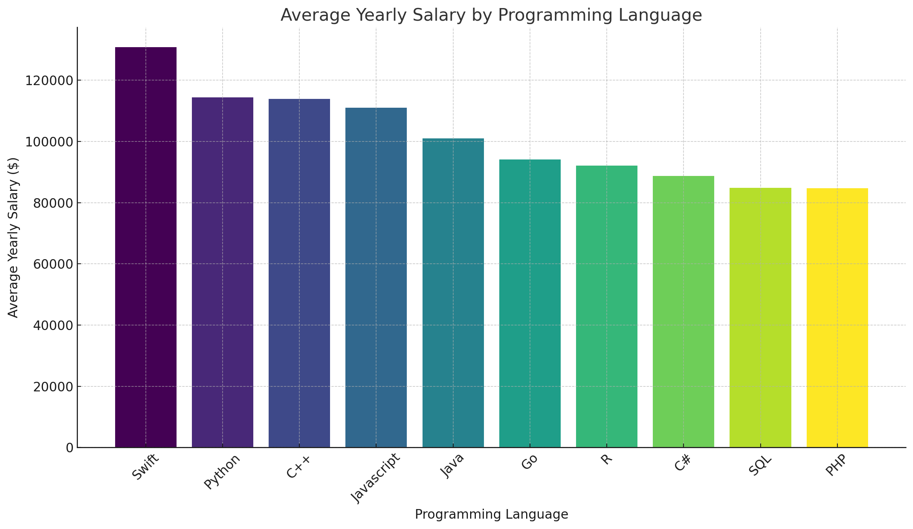
POPULAR LANGUAGES
In Module 1 you have collected the job postings data using web scraping in a file named “popular-languages.csv”. Present that data using a bar chart here. Order the bar chart in the descending order of salary.

